Slide 1
Καιρος – Team Atrius
Noah Gallo, Nathaniel Kanooni, Isaiah Hogue, Colby Nelson, Tre Carlton
Notes:
Colby

Slide 2



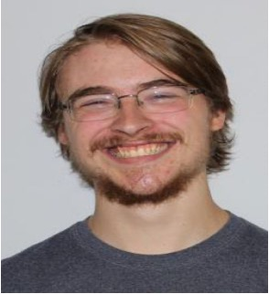

Nathaniel Kanooni
Tre Carlton
Noah Gallo
Isaiah Hogue
Colby Nelson
Notes:
Colby

Slide 3
Agenda
Updated Game Description
MVP Design and Status
Feature Overview
Demo
Demo
Project Status
Release Dates
Team Scrum Process
Overview
Sprint Summary
Scrum Adjustments
Learnings
Technical
Team
Features Status
Tools
Architecture
Notes:
Colby

Slide 4
What is Καιρος?
Notes:
Tre
Elevator Pitch Description (in case we change the slide): Kairos is an RTS Game set in a corrupted fantasy world in which you must fight to survive and reclaim the land. As the player, you will be able to build your kingdom and train units to help your people survive the corruption. Be careful however, because the corruption is always growing closer. Train up units in holy magic to help push the corruption back. Using many unique tools and strategies, you will be able to cleanse the world of this evil.

Slide 5




Tools
Notes:
Noah

Slide 6
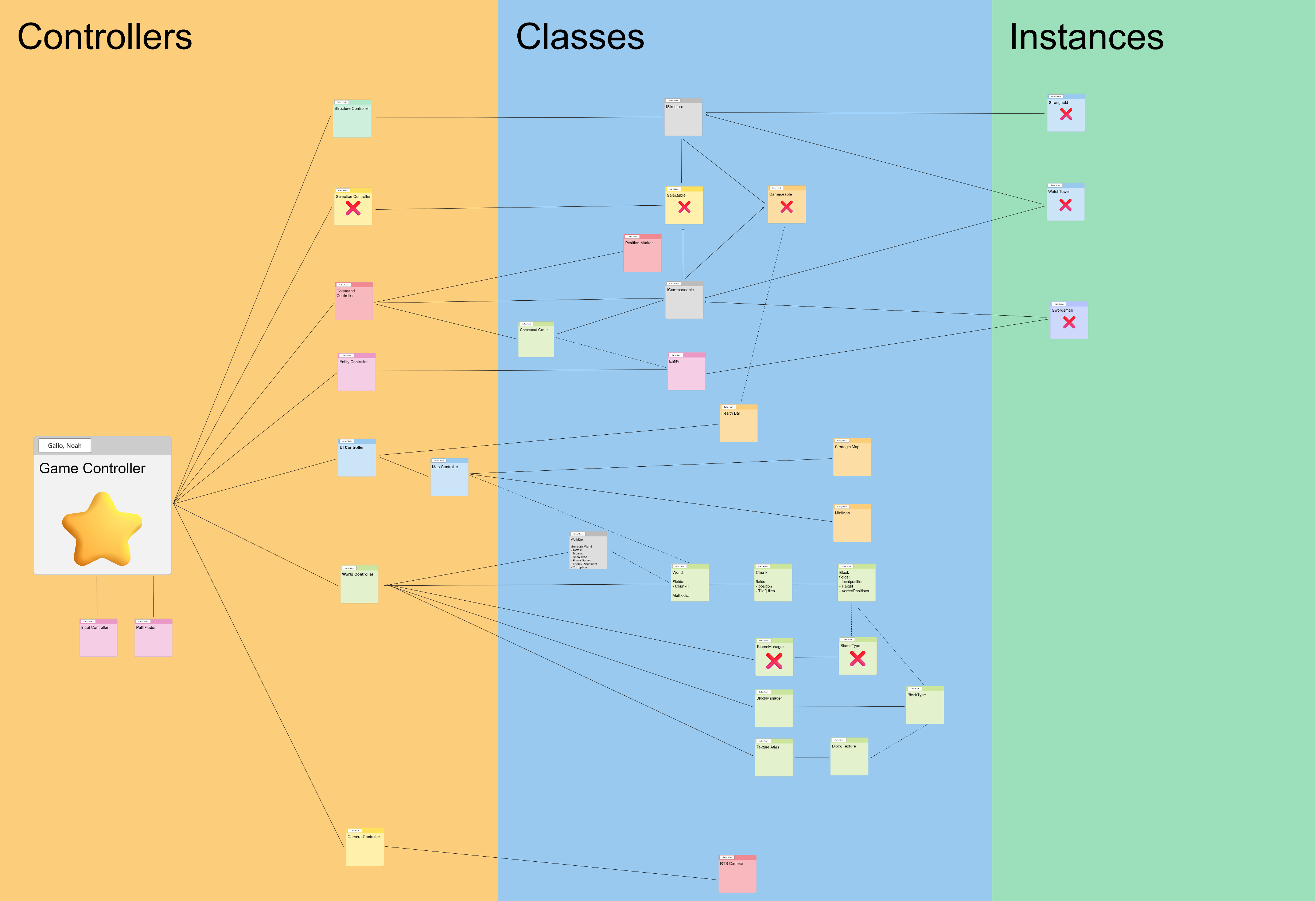
Project Architecture
Notes:
Noah

Slide 7

Kairos MVP
Notes:
Nathaniel

Slide 8
MVP Features
Procedurally Generated World
Corruption Opponent
Unit Movement and Combat
Deployable Structures
Notes:
Nathaniel

Slide 9
Feature Status
Procedurally Generated World
Voxel Based World with natural island generation - - - - COMPLETE
Corruption Opponent
Corruption spreads across the map - - - - - - - - - - - - - TODO
Enemies spawn from corruption and attack the player - - - - TODO
Player can push the corruption back - - - - - - - - - - - - TODO
Unit Movement and Combat
Units can reach their target while avoiding obstacles - - - COMPLETE
Units can engage in melee or ranged combat - - - - - - - - IN PROGRESS
Deployable Structures
Structures and resources placed randomly on world - - - - TODO
Structures can be built and placed by the player - - - - - COMPLETE
Structures can produce units - - - - - - - - - - - - - - - IN PROGRESS
Structures can research upgrade - - - - - - - - - - - - - - TODO
Notes:
Nathaniel

Slide 10

Demos
Notes:
We can add multiple slides to this just in case technology fails on us – Nathaniel K.

Slide 11
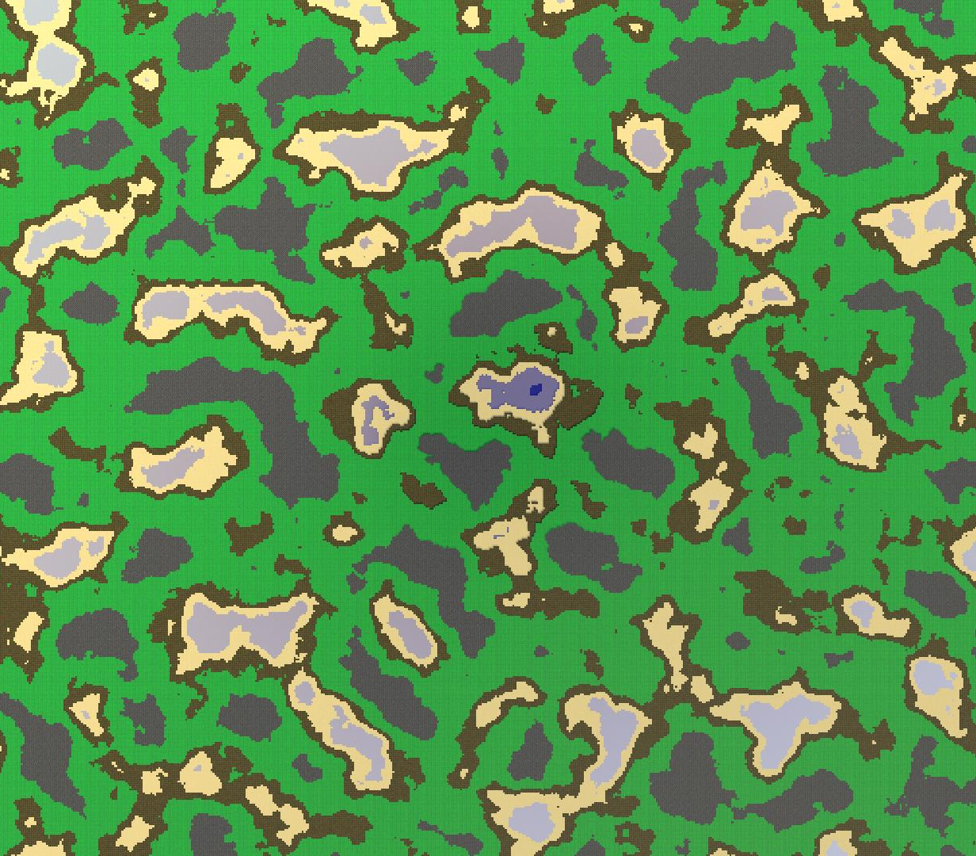
Map Generation
Notes:
Noah

Slide 12
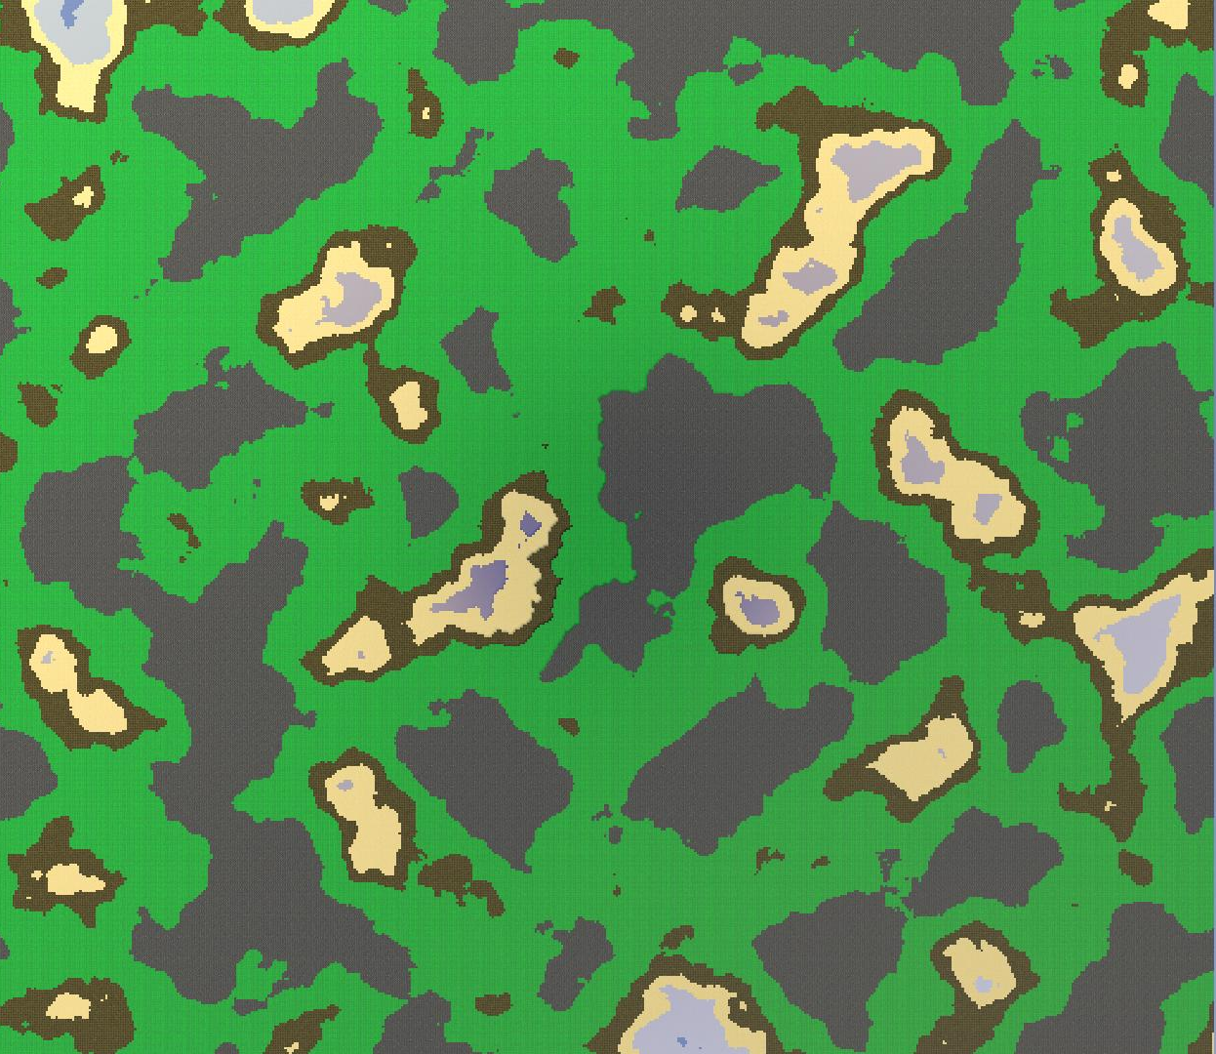
Map Generation
Notes:
Noah

Slide 13
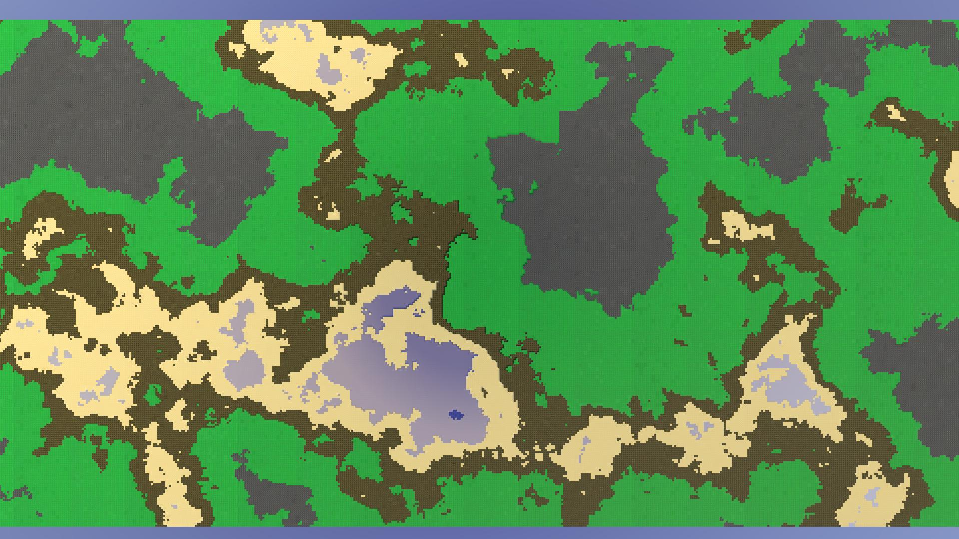
Map Generation
Notes:
Noah

Slide 14
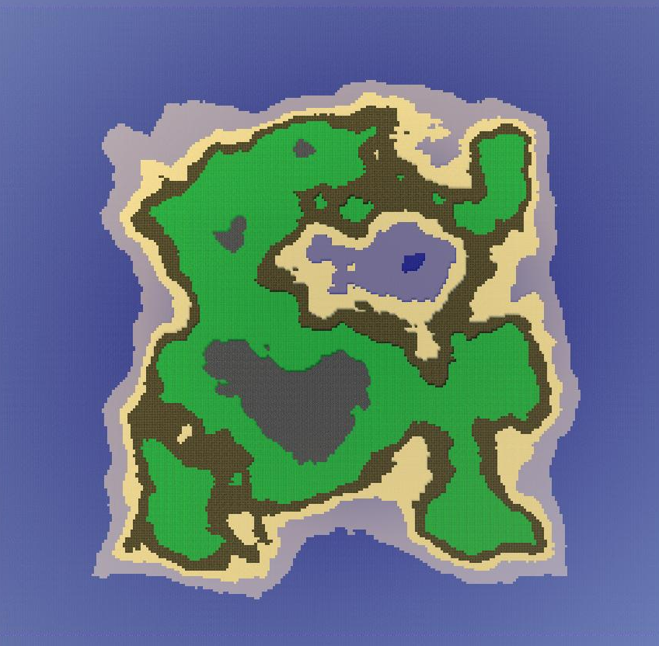
Map Generation
Notes:
Noah

Slide 15
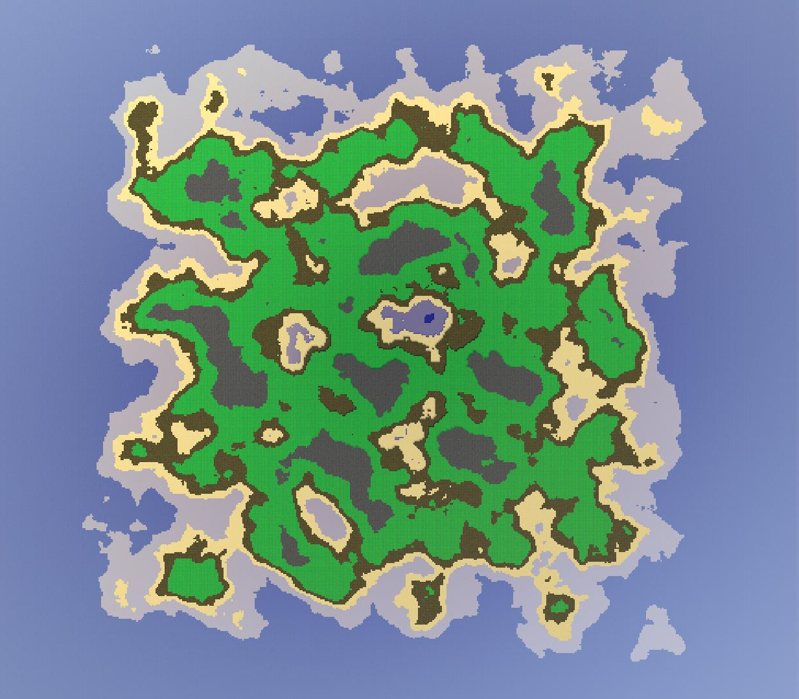
Map Generation
Notes:
Noah

Slide 16
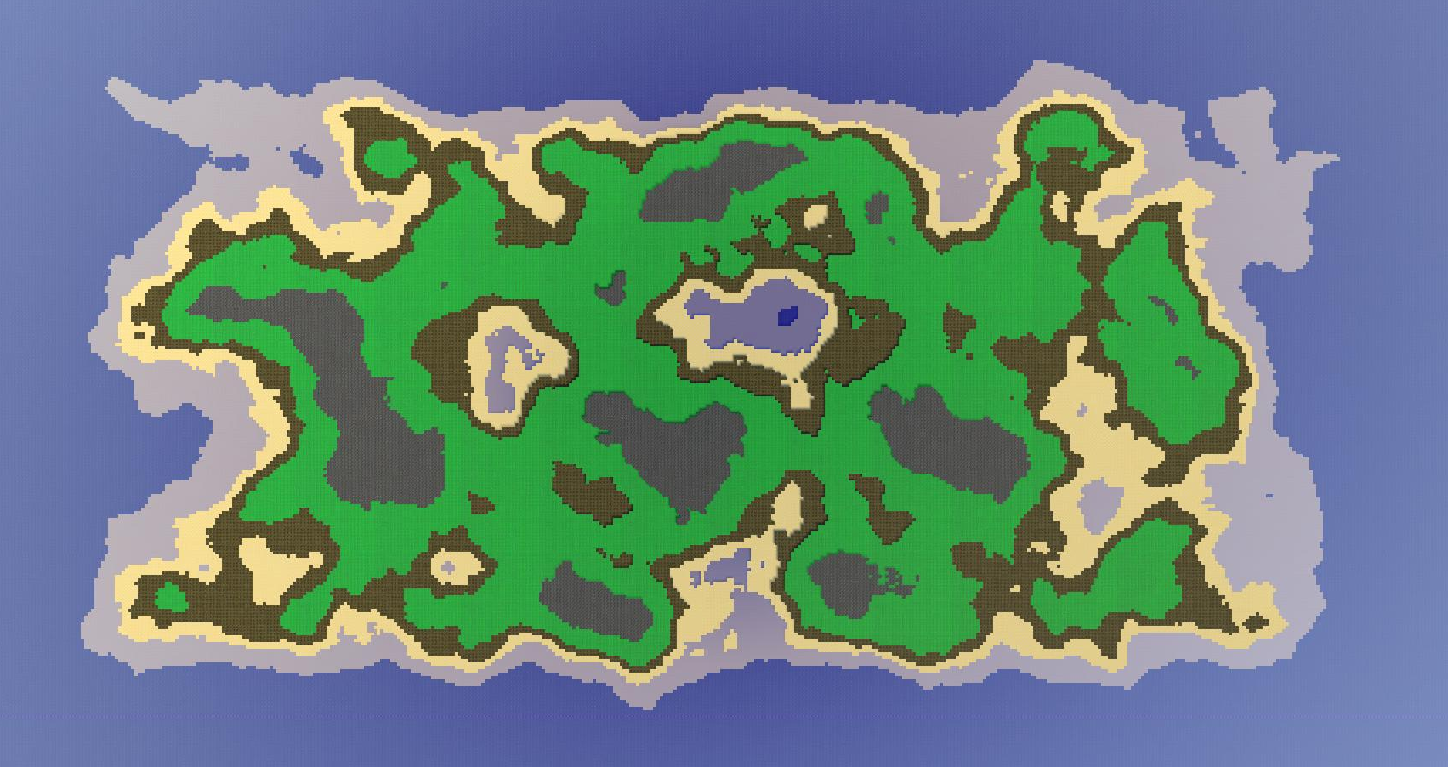
Map Generation
Notes:
Noah

Slide 17
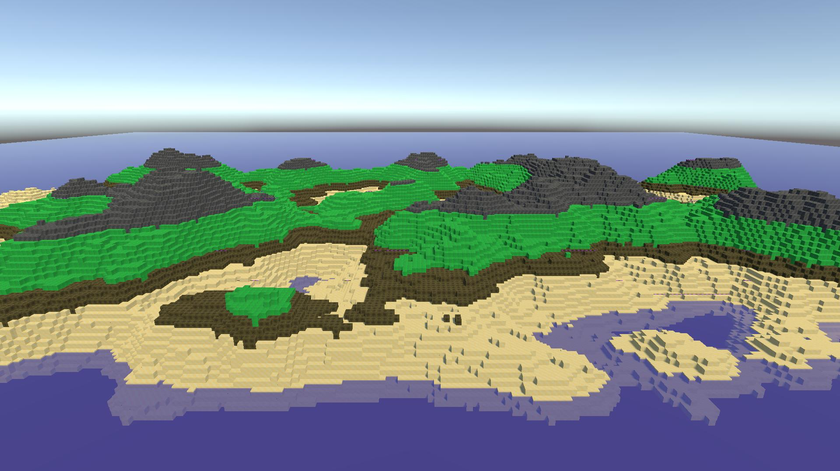
Map Generation
Notes:
Noah

Slide 18
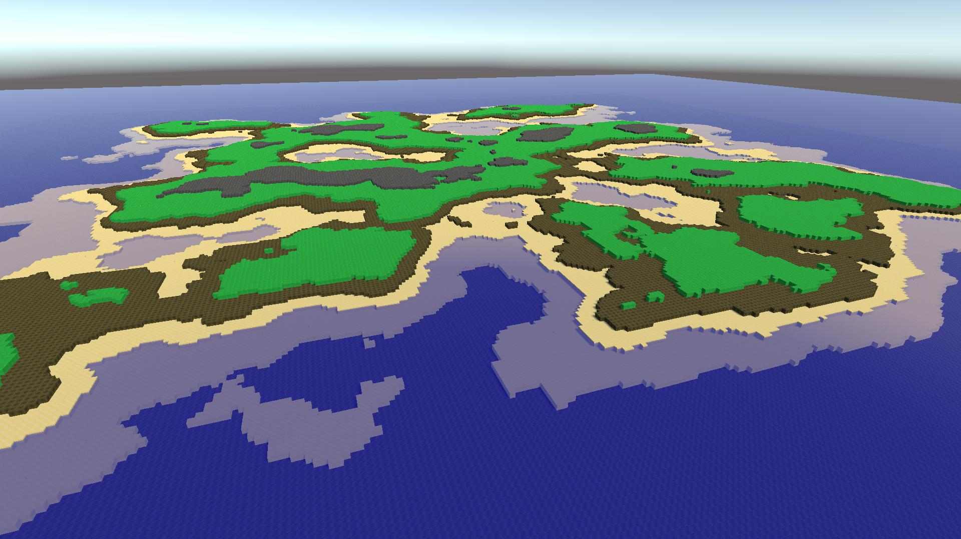
Map Generation
Notes:
Noah

Slide 19
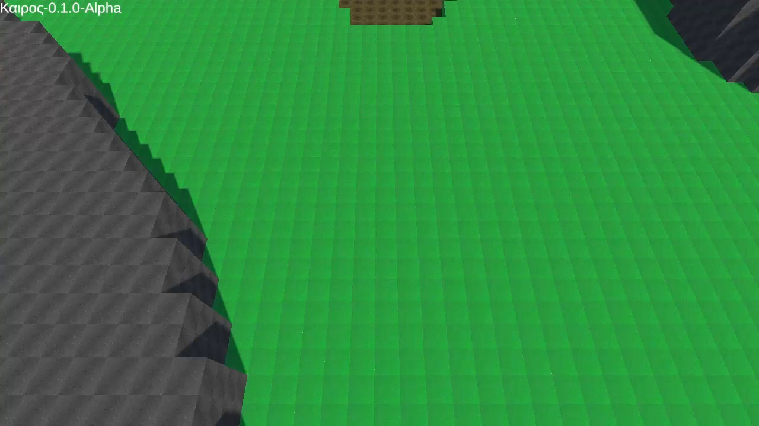
Unit Movement and Combat
Notes:
Isaiah

Slide 20
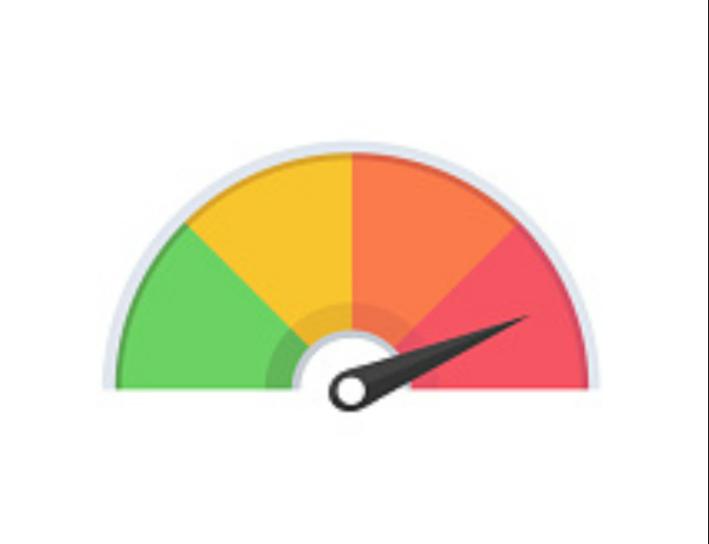
Project Status
Notes:
Colby
Status is subject to change ofc – Nathaniel Kanooni

Slide 21

Gameplay Demo

Slide 22
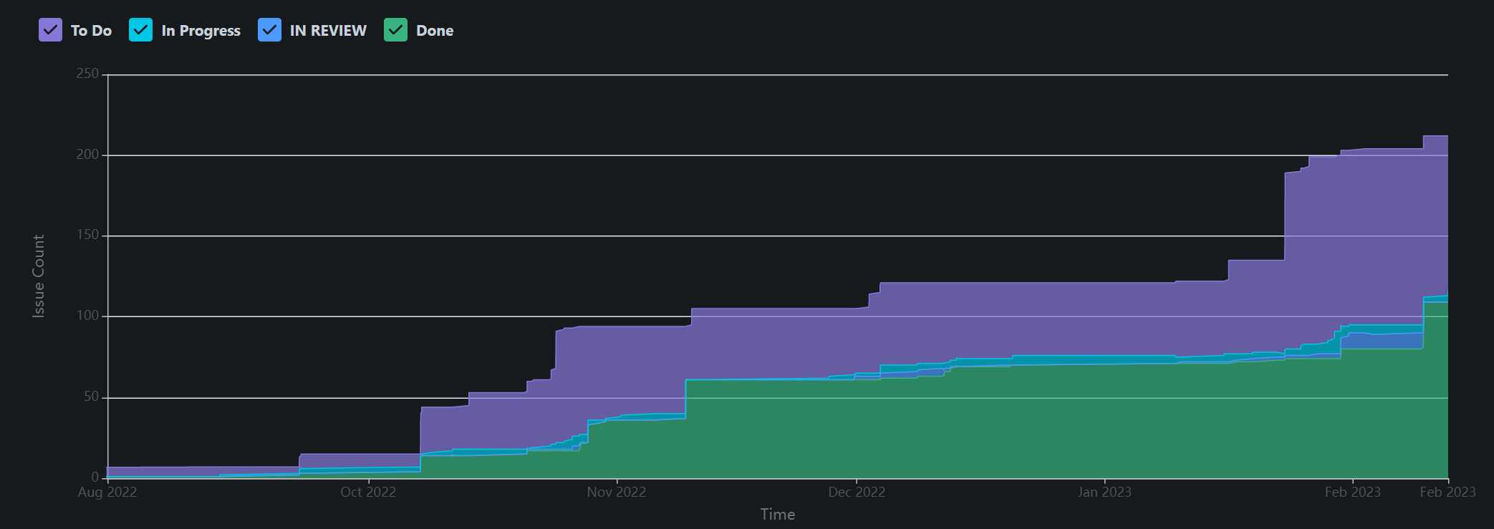
Project Flow
Notes:
Colby
50% Complete!!

Slide 23

Team Scrum Process
Notes:
Noah

Slide 24
Ideal Sprint
2-week sprints
Week 1 – Completing Assigned Tasks
Add new features
Fix old bugs
Week 2 – Reviewing and merging
Code Reviews
Merging into Development branch
Fix new bugs
Notes:
Noah

Slide 25
Scrum Adjustments
Sprint Length Adjustments
Started project with 2-week sprints meeting 4 times a sprint
Too long for keeping people on track
moved to 1-week sprints meeting 2 times a sprint
Higher pressure, but lacked review time
Moved back to 2-week sprints with daily meetings
High pressure, but allows for review time
Notes:
Colby

Slide 26
Learnings

Slide 27
Technical Learnings
Issues we have faced
Unity Development is unlike any other system we’ve use. We had to learn a brand-new style for development and repo management.
3D meshes are a unique problem that game developers face. Since the last meeting, we have done a lot of work managing our mesh vertices and triangles.
Algorithms and Data Structures
Boids
A*
Perlin Noise
Voxel Meshes
Priority Queue/Min Heap
Notes:
Isaiah

Slide 28
Team Learning
Team Management
How we handled it
Daily Meetings
Attendance Tracking
Reviewing Tasks daily
Project Organization
How we handled it
Enforced GitHub Pull Request
Lengthened sprints to allow for more review time
Still working on it…
Notes:
Noah
We have struggled with Team Management and productivity, but over the last few sprints, we have significantly boosted team productivity.
Project organization has suffered from the beginning. We have improved, but are still working on systems to make merging, reviewing, and overall task management more efficient
> Any other learning you want to share (and have time to share).
Dunno if this should have it’s own slide or not – Nathaniel K.

Slide 29
Intended Release Dates
24 Feb. 2023
Gameplay Demo released for community testing and feedback.
30 May 2023
Kairos Early Access MVP Release
Notes:
Tre

Slide 30
Questions?

